Slide 1
Time Frame Expansion
(Extended D-Algorithm)
Rishikesh Bose ( 2021702016 )
Nilesh Bawankar ( 2021702015 )
Ayu Parmar ( 2021702003 )
Sasanka GRS ( 2019112017 )

Slide 2
Sequential ATPG
Time Frame Expansion
A sequential circuit has memory in addition to combinational logic.
Test for a fault in a sequential circuit is a sequence of vectors, which
Initializes the circuit to a known state
Activates the fault
Propagates the fault effect to a primary output
Methods of sequential circuit ATPG
Time-frame expansion methods
Simulation-based methods
Conjectures:
We consider the faults to be present only in the Combinational Part of the circuit
We consider only Single Stuck-at-Faults
Controllability of Seq. Nodes are initialised with infinity contrary to Combinational circuits where it is 1
Saving time complexity
Using more memory in a clock cycle and saving total no. of clock cycles required for testing
Dividing each state of the circuit into an individual “time frame”.

Slide 3
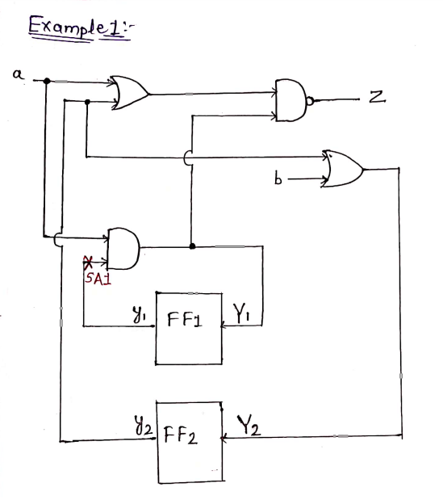
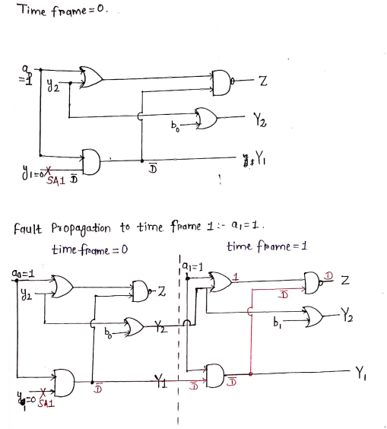

Slide 4
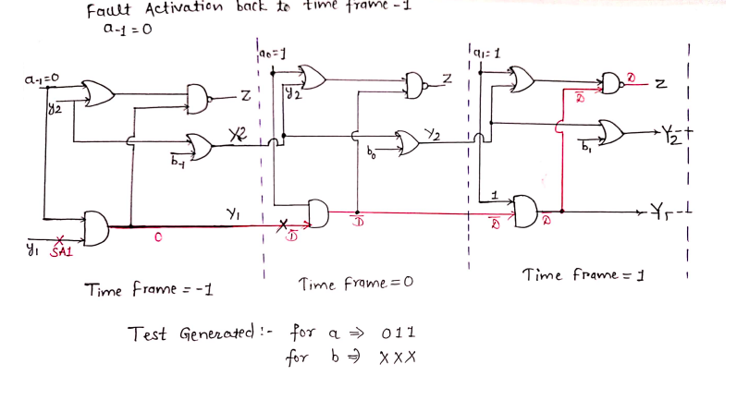

Slide 5
Plan of Implementation
Initialization of stuck at faults in the circuit.
Propagation of faults.
Activation of fault at time t = 0,1,-1.
Generating GTK waveforms.
We will code for both sequential and combinational circuit.

Slide 6
Thank You!

